Slide 1
Design and Visual Guide

Slide 2
The Jesuit Refugee Service brand is more than our logo. Our brand is our reputation—the way people feel when they interact with our organisation, services, employees, and communications.
The key to creating a valuable experience is the continued and consistent expression of our brand strategy—our vision, mission, values, and purpose.
The design and visual guide provides guidance on the main graphic elements of JRS.

Slide 3
Index
Logo
Primary Version
Variations
Region/Country Lockup Templates
Dimensions
Don’ts
Colours and font
Colours
Colour palette
Fonts
Photography
Examples
Social Media
Templates
Letterhead
Business Card
Email Signature
Cover Pages
Power Point Presentation
Contacts
5
6
7
8
12
13
14
15
17
18
20
22
23
24
26
27
28
29
30
31

Slide 4
LOGO
Click here to see all the logo files

Slide 5
Logo Primary Version
Use this version as much as possible, as this version of the logo is the intended use of the symbol and logotype together.

Slide 6
Logo Variations
Symbol Only
Use when JRS's name and initials are already spelled out elsewhere. For example: profile photos on social media.
Primary - No Tag
Use only when the reproduction of the logo is too small for "Jesuit Refugee Service" to be read.
Primary - Solid White
Use only when you have dark backgrounds where there is not enough contrast to make the full colour version legible.
Primary - Solid Black
Use only when you are printing in black and white.

Slide 7
Logo Region/Country Lockup Templates
JRS is globally known by its English name “Jesuit Refugee Service”. We encourage you to use the primary logo as much as possible as we are all part of the same global organization.
In case you have to identify your region or country, you will need an additional element of the logo that includes the name of your region/country.
In case you have to translate “Jesuit Refugee Service” in your language, we recommend to always use bilingual versions of the logo.
The following slides show all the possible variations of the region and country logos, and they apply to all languages.

Slide 8
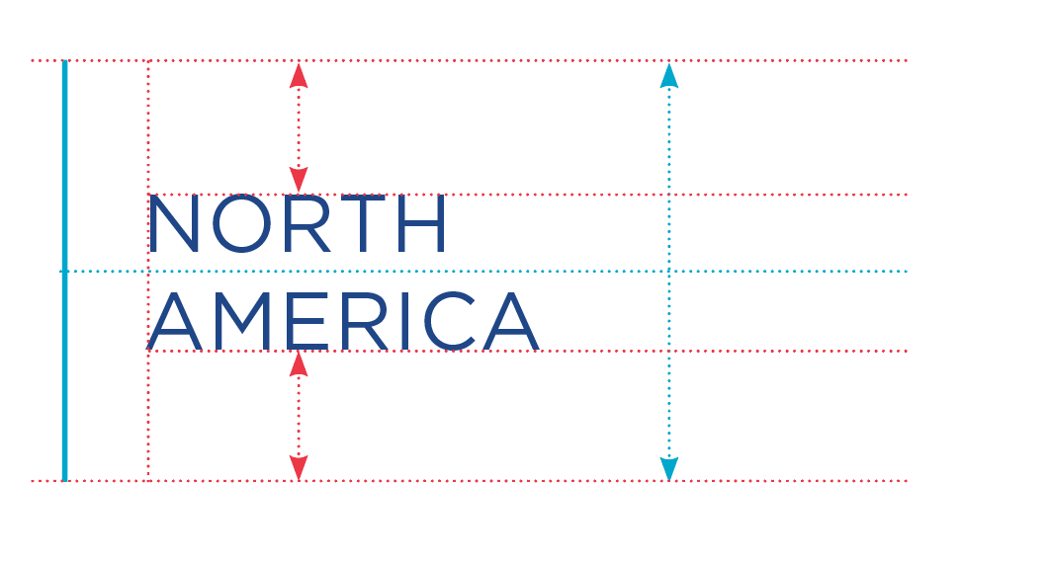
Logo Region/Country Lockup Templates
Always Keep Text Vertically Centered

Slide 9
Logo Region/Country Lockup Templates – Other Languages
If you need to translate “Jesuit Refugee Service” in your local language, put it on the right side of the logo.

Slide 10
Logo Region/Country Lockup Templates – Other Languages
If you need a more compact version, use this vertical variation

Slide 11
Logo Region/Country Lockup Templates
Region and country lockups can also be used in the solid white and solid black variations.

Slide 12
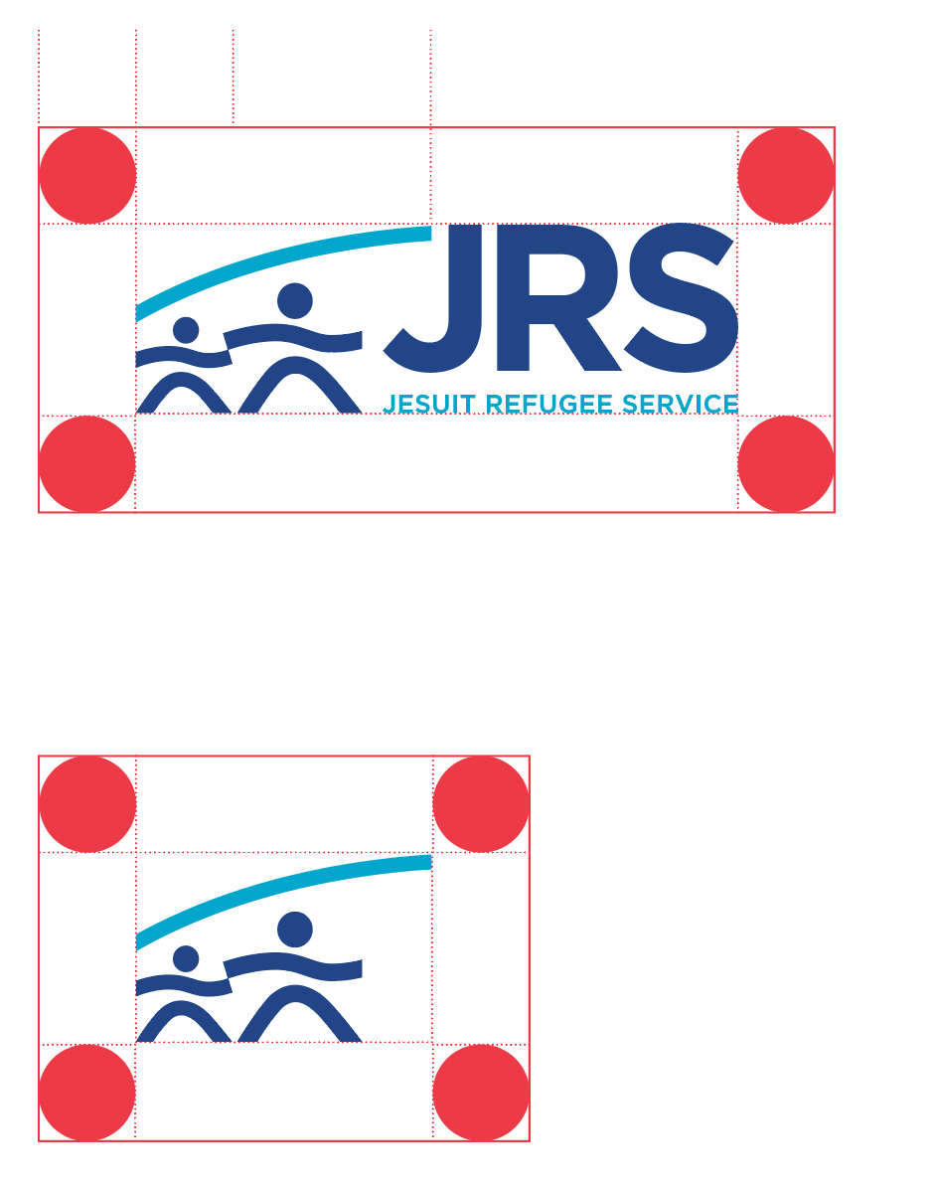
Logo Dimensions
CLEAR SPACE
There should always be ample space around the logo to ensure maximum impact and keep the mark from looking cluttered.
34% Width of Arc
FULL LOGO
MINIMUM LOGO SIZE
Width: 1.5 inches or 144 pixels
1.5 in or 144px
Note: When the width is less than 1.5 inches, use the lockup that DOES NOT include the full “JESUIT REFUGEE SERVICE” nomenclature.
SYMBOL

Slide 13
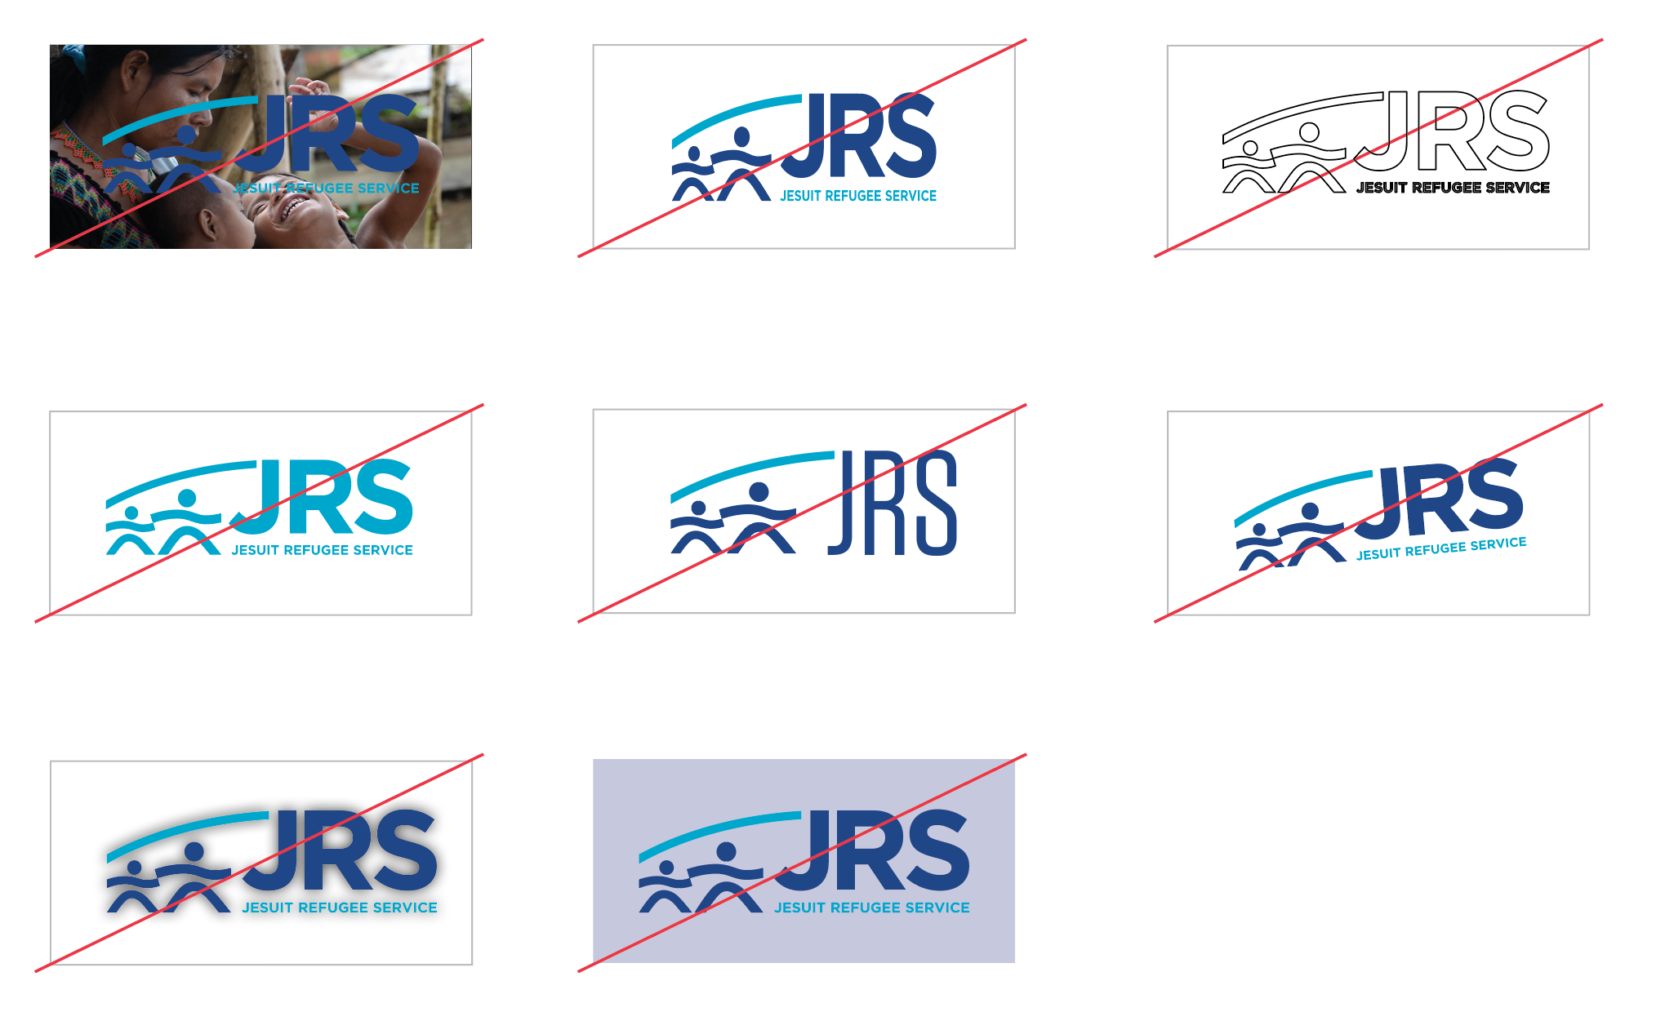
Logo Don’ts
Don’t place directly on cluttered backgrounds or patterns
Don’t stretch or skew. Hold down the control key (Ctrl) while dragging a corner of the logo to scale it proportionally.
Don’t turn into outlines
Don’t recolour
Don’t change fonts
Don’t rotate
Don’t add drop shadow
Don’t use a background that gives low contrast

Slide 14
Logo Colours and font
PMS: 7687
CMYK: 100/86/15/3
RGB: 31/67/136
HEX: #214885
PMS: 312
CMYK: 96/6/15/0
RGB: 0/166/206
HEX: #1BA7CB
Dark Blue
Light Blue
The logo font is Gotham Book. You can download it from this link.
Use this font exclusively for the logo, as it is not licensed for use on any other item and you may violate copyright laws.

Slide 15
COLOURS

Slide 16
Colours
Consistency in the use of colours is essential: it reinforces our brand and strengthens recognition of our organisation.
The colours of the logo are JRS’s primary colours. We encourage the use of the primary colours, especially the dark blue, on most materials.
Text and assets can also be used in black and white.
If you need additional colours, you can select them from our colour palette.

Slide 17
Colours Colour palette
PRIMARY
PMS: 7687
CMYK: 100/86/15/3
RGB: 31/67/136
HEX: #214885
PMS: 312
CMYK: 96/6/15/0
RGB: 0/166/206
HEX: #1BA7CB
SECONDARY
PMS: 138
CMYK: 11/59/100/1
RGB: 220/125/17
HEX: #DC7D11
PMS: 3262
CMYK: 75/2/36
RGB: 0/182/178
HEX: #00B6B2
Dark Teal
Gray
PMS: 7712
CMYK: 86/39/28/3
RGB: 1/126/156
HEX: #017E9C
PMS: 431
CMYK: 66/55/45/20
RGB: 91/97/107
HEX: #5B616B
Green
TERTIARY
PMS: 7737
CMYK: 60/13/100/1
RGB: 119/170/43
HEX: #77AA2B

Slide 18
FONTS

Slide 19
Fonts
Fonts are one of the most important design elements. They create brand consistency across all materials.
Our primary font is Montserrat, a free font that can be used across all channels and in print.
Gotham Book, our logo font, can only be used for the logo, as any other use would go against copyright laws.
Use Arial for emails as the use of other fonts may activate spam filters.
Click here to download JRS fonts

Slide 20
PHOTOGRAPHY

Slide 21
Photography
Photography is a key tool for amplifying refugee voices, building empathy, and highlighting JRS’s work around the world. However, the use of photos and videos can cause harm if not held to high ethical standards.
When gathering and using photos and videos you must follow these rules:
Make sure you do NOT portray people in undignified situations. Our purpose is not to show people suffering but to show their resilience
Protect the identity of vulnerable people and children
Seek informed consent and always respect the wishes of the people you portray
Respect copyright laws
READ THE POLICY ON THE ETHICAL USE OF IMAGES
READ THE GUIDELINES TO GATHER VISUAL CONTENT

Slide 22
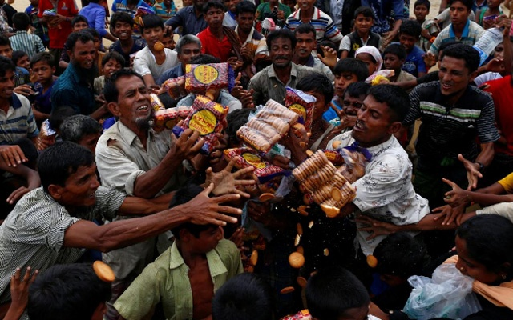
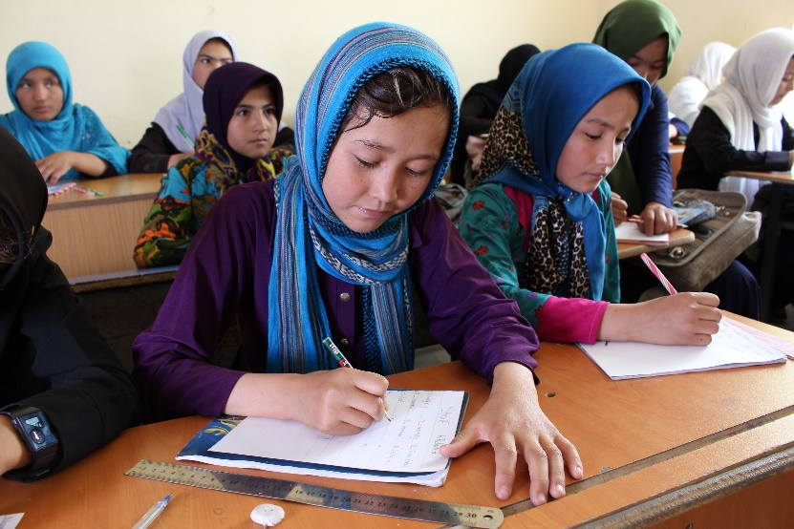
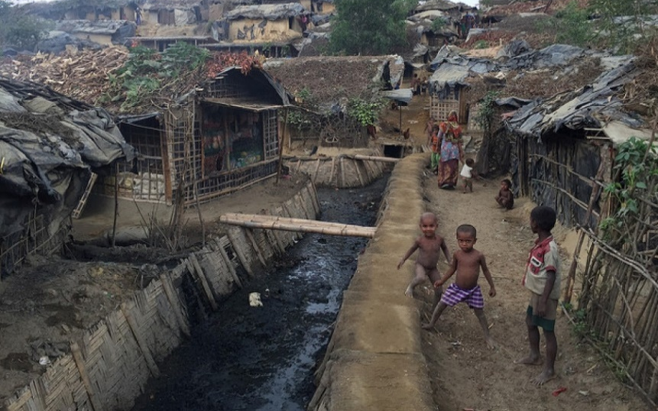
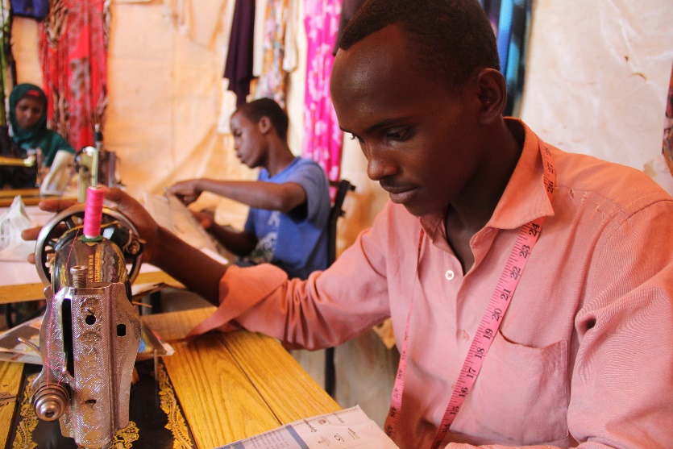
Photography Examples
X
✓
X
✓

Slide 23
SOCIAL MEDIA

Slide 24
Social Media
Use the symbol only variation of the logo as your profile image
Make sure your posts are legible, clean, and eye-catching.
Use consistent and simple design elements, and let the photographs and quotes speak for themselves.
Try to focus on one person at a time, and highlight one or two short sentences from the story you are trying to tell in the graphic. Alternatively, the one or two short sentences could be used as a caption.
It is not necessary to include the JRS logo on every post.
Social media are being updated frequently. Make sure you are up-to-date with image dimensions, layouts, and requirements to upload visual content. Consult this guide when in doubt.

Slide 25
Social Media Examples

Slide 26
TEMPLATES

Slide 27
Templates
The use and adaptation of templates for stationery and presentations are recommended to ensure a consistent visual identity, especially when used for audiences that are external to JRS.
CLICK HERE TO SEE ALL TEMPLATES

Slide 28
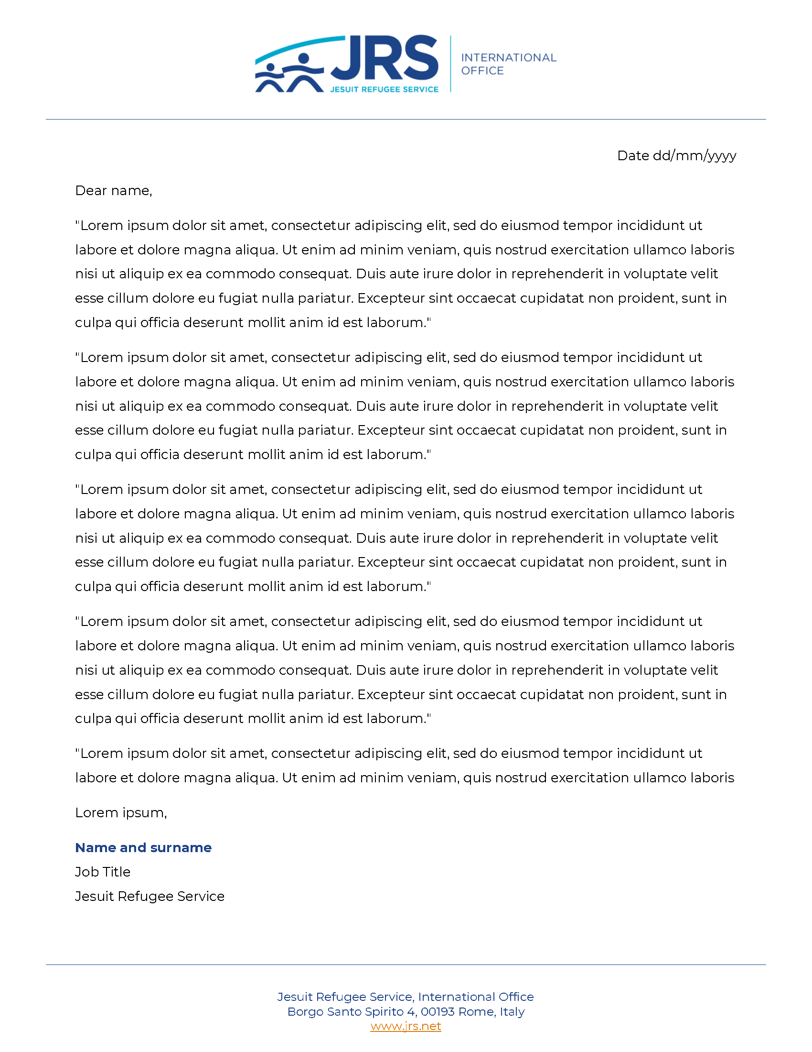
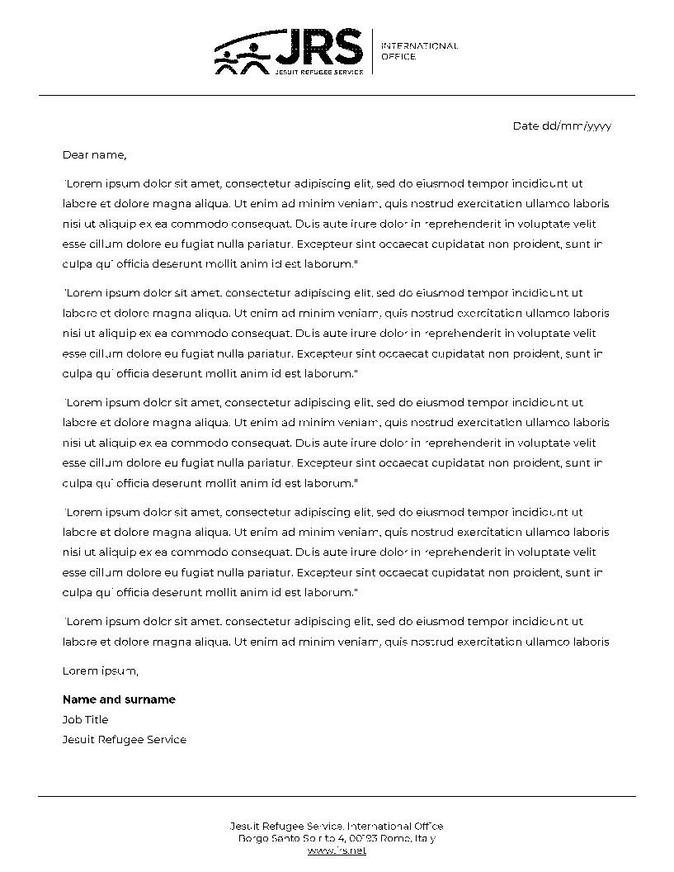
Templates Letterhead
Full colour
Black and white
The letterhead templates are available through this link.

Slide 29
Templates Business Card
The business card template, and all related assets and working files, are available through this link.
Margins: 4mmm
Montserrat Medium , 12pt
Montserrat Semi bold, 9pt
Montserrat Medium, 8pt
Line width: 0.25 mm
Line height: 0.25 mm
Montserrat Semi bold, 8pt

Slide 30
Templates Email Signature
Make sure you use the font Arial in every email design as other fonts might activate spam filters and prevent your email from being received.
Template
Example
Font: Arial, 10 pt
Line Spacing: 1.5
Name
Job Title
Office: Office Number │ Mobile: Mobile Number
Jesuit Refugee Service │ Local Office
Local Office address
Links to website and social media channels
Primary Logo or full colour region/country variation
Thomas H. Smolich SJ
International Director
Office: +39 0669868623 │ Mobile: +39 3339944423
Jesuit Refugee Service │ International Office
Borgo Santo Spirito 4, 00193, Rome, Italy
Website Facebook Twitter Instagram YouTube
JRS Blue: RGB 31/67/136
JRS Orange: RGB 220/125/17

Slide 31
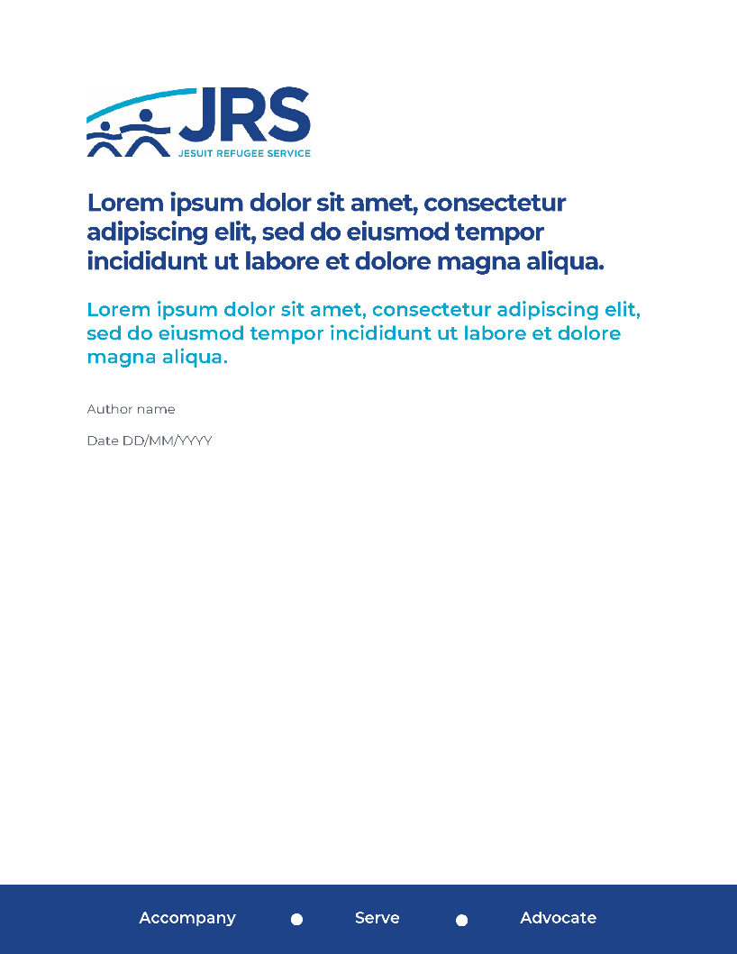
Templates Cover Pages
The cover pages templates are available at this link.
Feel free to use them for reports, policies, publications, and any other official JRS document.

Slide 32
Templates Power Point Presentation
The Power Point Presentation template is available through this link.
Title slide
Text slide
Photo slide
Chart slide

Slide 33
Contacts
Typography is one of the most important design elements. It creates brand consistency across all materials. Gotham is the font used in the JRS logotype. Montserrat is a very similar, but free, font that can be used across all channels and in print. The consistent use of these typefaces builds a unified impression for JRS.
If you need support, contact:
Francesca Segala
Digital Communications Officer
francesca.segala@jrs.net
Martina Bezzini
International Communications Officer
martina.bezzini@jrs.net

